Slide 1
Body Fat Calculator
STAT 628 Module 2 Group 11

Slide 2
Data Exploration
We first convert weight and height to metric units, in line with the other variables
Look at some plots and the summary statistics for the predictor variables
We immediately notice there are a few points that may have issues: - There is outlier for Age, Weight, and Height
We can see from the plots on the following slide

Slide 3
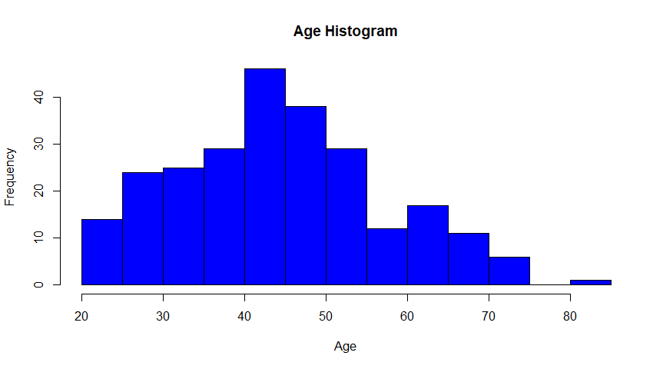
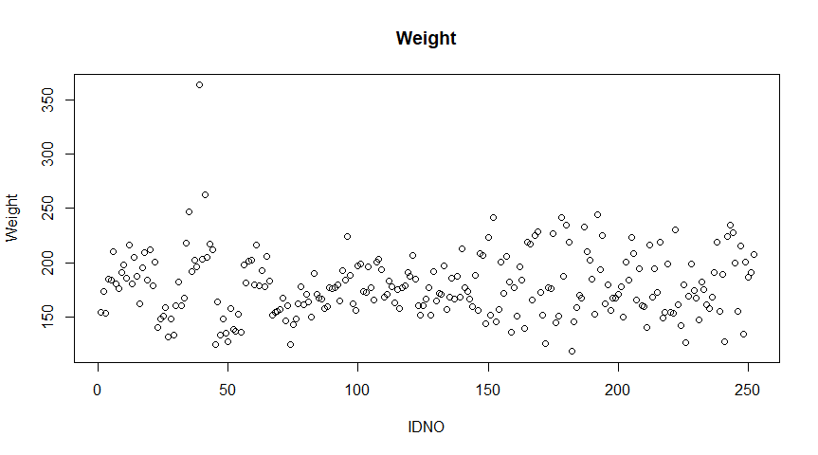
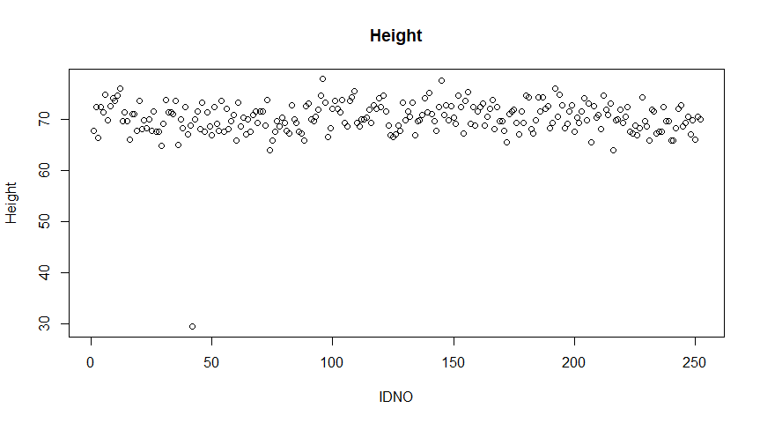

Slide 4
Outliers
IDNO | Reason | How to proceed
39 | Has the max value for weight adiposity, neck, chest, abdomen, hip, thigh, and knee, clearly an outlier from the plot | Remove from data
42 | Height unreasonably low | Attempt to recover
79 | The sole individual with age above 80 | Remove from data

Slide 5

Recover height using weight+adiposity
Notice that IDNO42 has height 29.5 inches/74.93cm, which is unreasonable
Can recover using $Adiposity=\frac{703∙Weight(lb)}{Heigh{t(inch)}^{2}}=\frac{Weight\left(kg\right)}{Height{\left(cm\right)}^{2}}$
We have:
IDNO | Original | Recovered | Reasonable?
42 | 29.5 inches/74.93cm | 69.43 inches/176.34cm | Yes

Slide 6

Bodyfat variable
Next, we check whether there are any issues with the response variable body fat
There is a direct relationship between body fat and density that is shown by Siri’s equation: $Bodyfat=\frac{495}{Density}−450$
We use this to see if there are any wrong values for bodyfat by plotting bodyfat against density

Slide 7
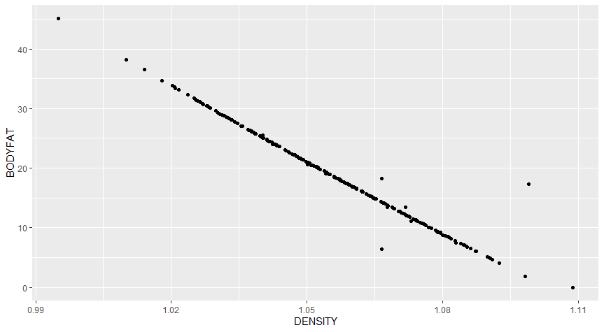
Bodyfat vs density plot

Slide 8
Recover data using Siri’s equation
Clearly, some values are wrong as they deviate from the line
There are issues for IDNO48, 76, 96, 182
Using Siri’s Equation, we have the following:
IDNO | Original | Recovered | Reasonable and Keep?
48 | 6.4 | 14.1 | Yes
76 | 18.3 | 14.1 | Yes
96 | 17.3 | 0.4 | No
182 | 0 | -3.6 | No

Slide 9
Bodyfat data
From Google, we learn that bodyfat percentage <3% is unreasonable
Using this, we can filter out the data for IDNO172, which has bodyfat value of 1.9

Slide 10
Data Cleaning Summary
We deleted IDNO39, 79, 96, 172, 182 from data
We recovered data for IDNO42, 48, 76
Final cleaned data: n=247 individuals with all the original predictors

Slide 11
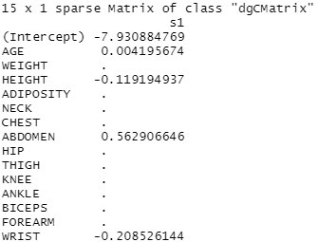
Variable Selection
We used LASSO for variable selection
We see that Age, Height, Abdomen and Wrist are the most important variables

Slide 12
Age variable
For age, we decided to turn it into a categorical variable with age 40 as cutoff between 2 groups
This is due to research paper we read online studying the effect of age on bodyfat

Slide 13

Models for Bodyfat
Metric for Model Performance: 1. Adjusted $R^{2}$ 2. MSE
Using the predictor variables we selected, we then try the following models and compare their performance: 1. Random Forest 2. XGBoost 3. Multiple Linear Regression using Leave-one-out Cross Validation

Slide 14
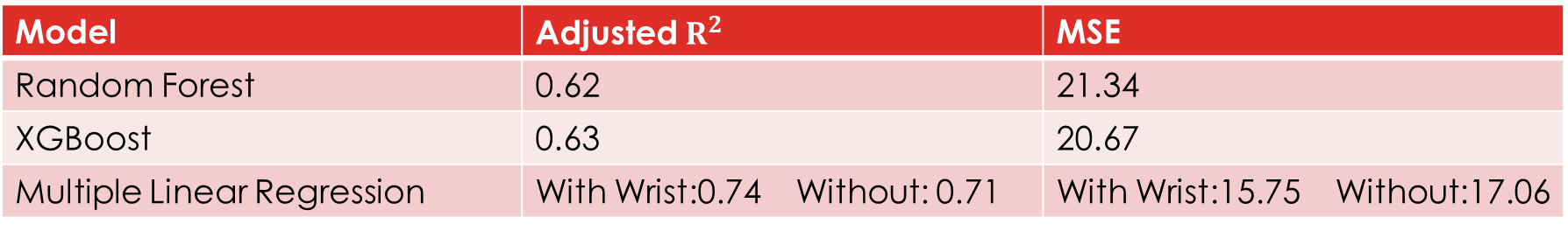
Model Performance
Based on the results above, we proceed with using Multiple Linear Regression Model
Note that we tried one model with wrist and another without so that wrist can be an optional input in the Shiny App for user convenience
Model | Adjusted $R^{2}$ | MSE
Random Forest | 0.62 | 21.34
XGBoost | 0.63 | 20.67
Multiple Linear Regression | With Wrist:0.74 Without: 0.71 | With Wrist:15.75 Without:17.06

Slide 15

Final Model
$Bodyfat \%=9.39+0.71Abdomen−0.14Height −1.74Wrist+1.14\left(Age 40\sim 80\right)$
Or, if the user wants a simpler model with no wrist required, then it would be: $Bodyfat \%=−1.73+0.63Abdomen−0.21Height +0.75\left(Age 40\sim 80\right)$

Slide 16
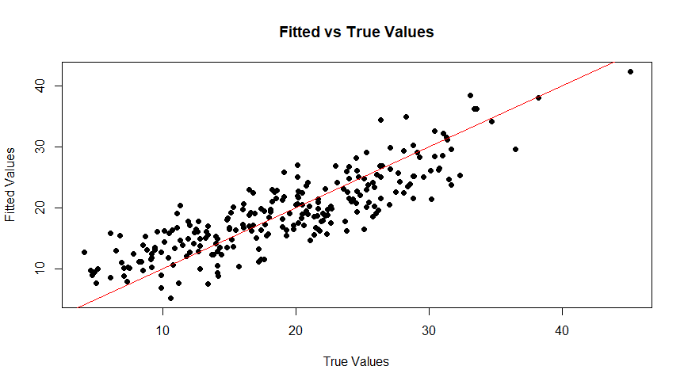

Slide 17
Results
Some results of the model:
1cm increase in abdomen -> body fat increase by 0.707%
1cm increase in height -> body fat decrease 0.138%
1cm increase in wrist -> body fat decrease 1.742%

Slide 18
Examples
Average American male (69inch height, 40.5 inch waist, 7.25 inches wrist): <=40: 25.76%, CI:[24.60%, 26.91%]; >40: 26.91%, CI:[26.08%, 27.73%]
Usain Bolt (76.77inch height, 33 inch waist, 7.25 inch wrist ): Body fat 9.58% , CI:[8.06%, 11.09%]

Slide 19
Model Diagnostics
We need to check Multiple Linear Regression assumptions: - Normality - Homoscedasticity - No Multicollinearity

Slide 20
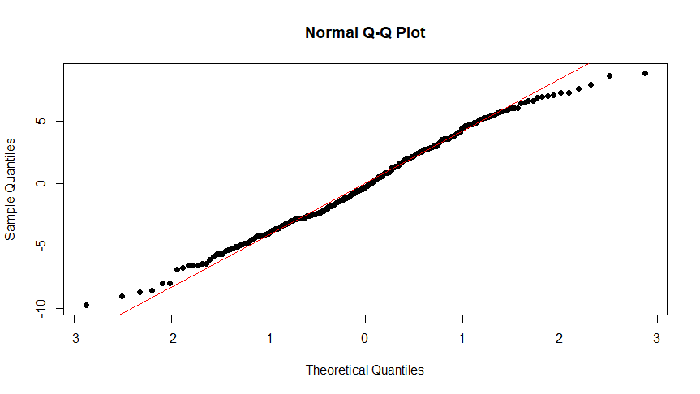
Normality
We look at QQplot for residuals as well as perform the Shapiro test
Shapiro test p-value: 0.076

Slide 21
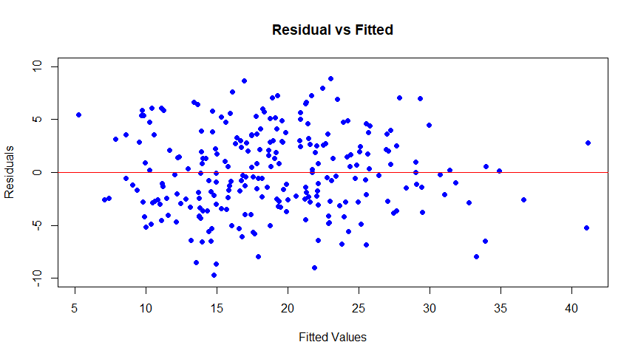
Homoscedasticity
We have the following residual plot:

Slide 22
Multicollinearity
We use the variance inflation factor (VIF) to check whether there is multicollinearity in the model
We see VIF value for each variable is lower than 2
Conclusion: No multicollinearity issue

Slide 23

Strengths/weaknesses
Strengths: - Decent $R^{2}$ - Simple and easy to use + interpret
Weaknesses: - It might not generalize well for individuals outside the range of our data, such as people <20 or > 80 - Dataset population low

Slide 24
Shiny app demonstration
https://tinghuixu1114.shinyapps.io/bodyfatcalculator-group11/

